Slide 1

Implementing AWS for Salary Analysis
Group 8: Jupiter Kang, Crystal Kao, Alonso Romero

Slide 2
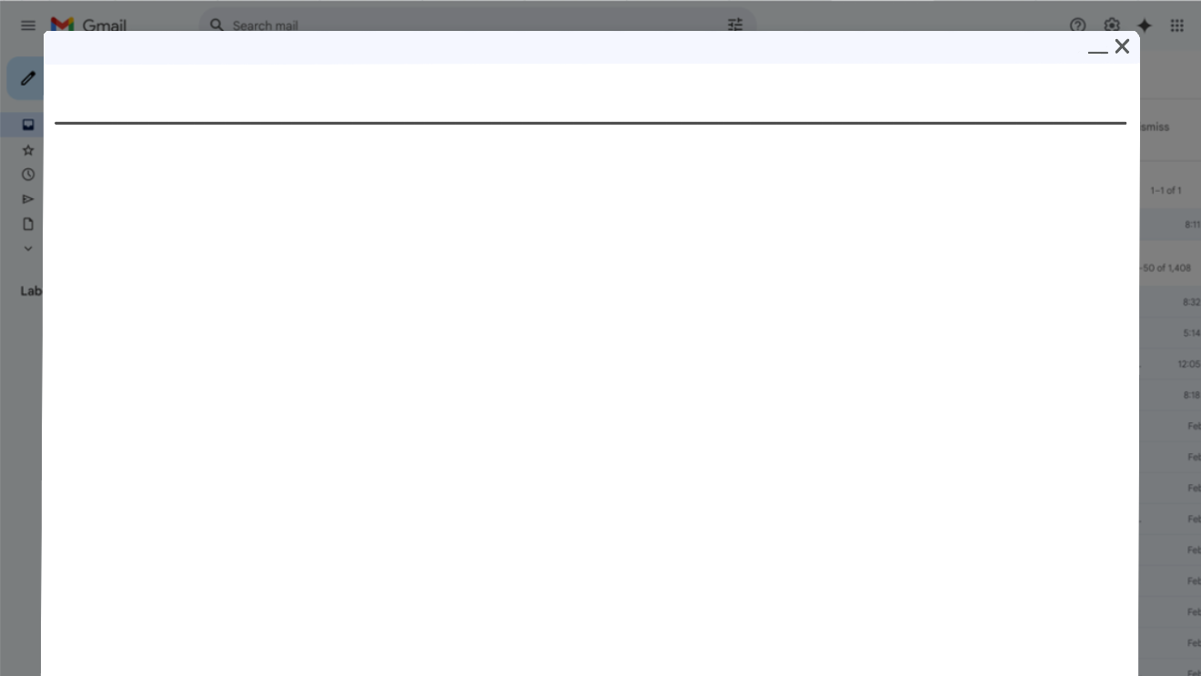
Scope of Project
Objective: Compare salaries of job listings based on if AWS is listed as a requirement in the description to see if knowing AWS pays more than jobs without AWS in the description
Compared to all data science job listings in 2017 on Glassdoor
Goal: Create a dashboard in QuickSight to visualize our findings

Slide 3
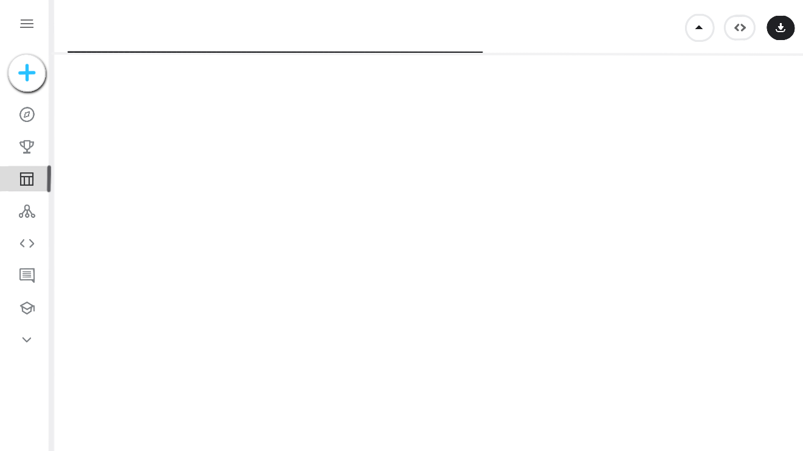

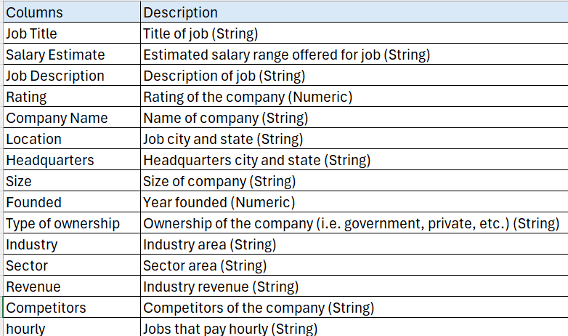
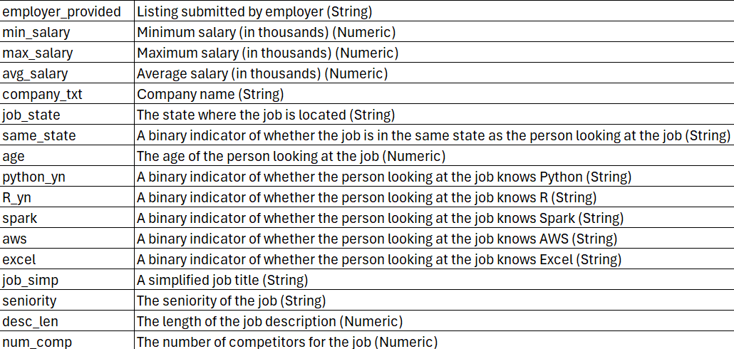
Data Source and Features
2017-2018 data: https://www.kaggle.com/datasets/thedevastator/jobs-dataset-from-glassdoor/data
32 columns, 742 rows

Slide 4

Features to Implement
S3 Bucket
Store data in buckets
Create static website to display findings in one place
VPC
Create internet gateways, subnets, and routing tables for EC2 instances
EC2
Create instances from computing sources in the cloud
Run a Jupyter Notebook or Python file to preprocess data
QuickSight
Connect with data from S3 bucket to create dashboards
Create histogram to show the distribution of salaries

Slide 5
Project Architecture
S3
Website
Kaggle Dataset
Raw Data
QuickSight
VPC
Public Subnet
Private Subnet
EC2
EC2
Python File

Slide 6
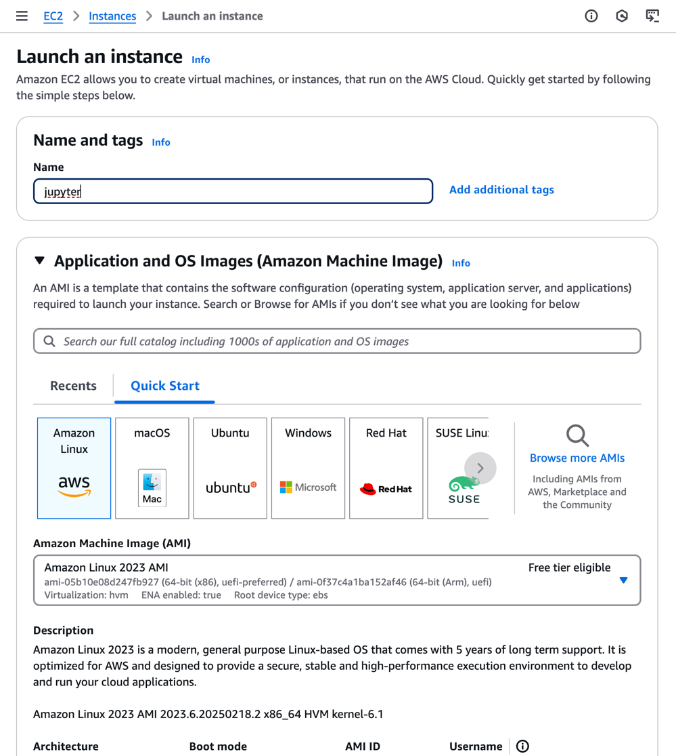
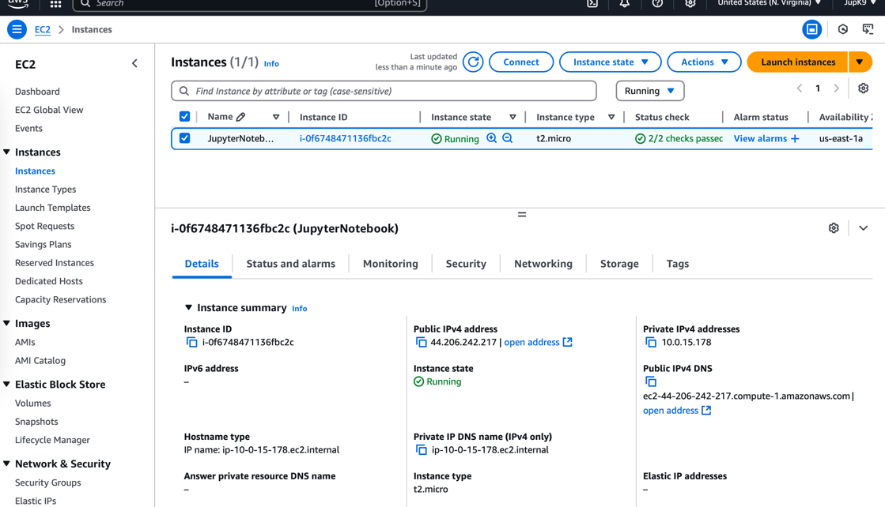
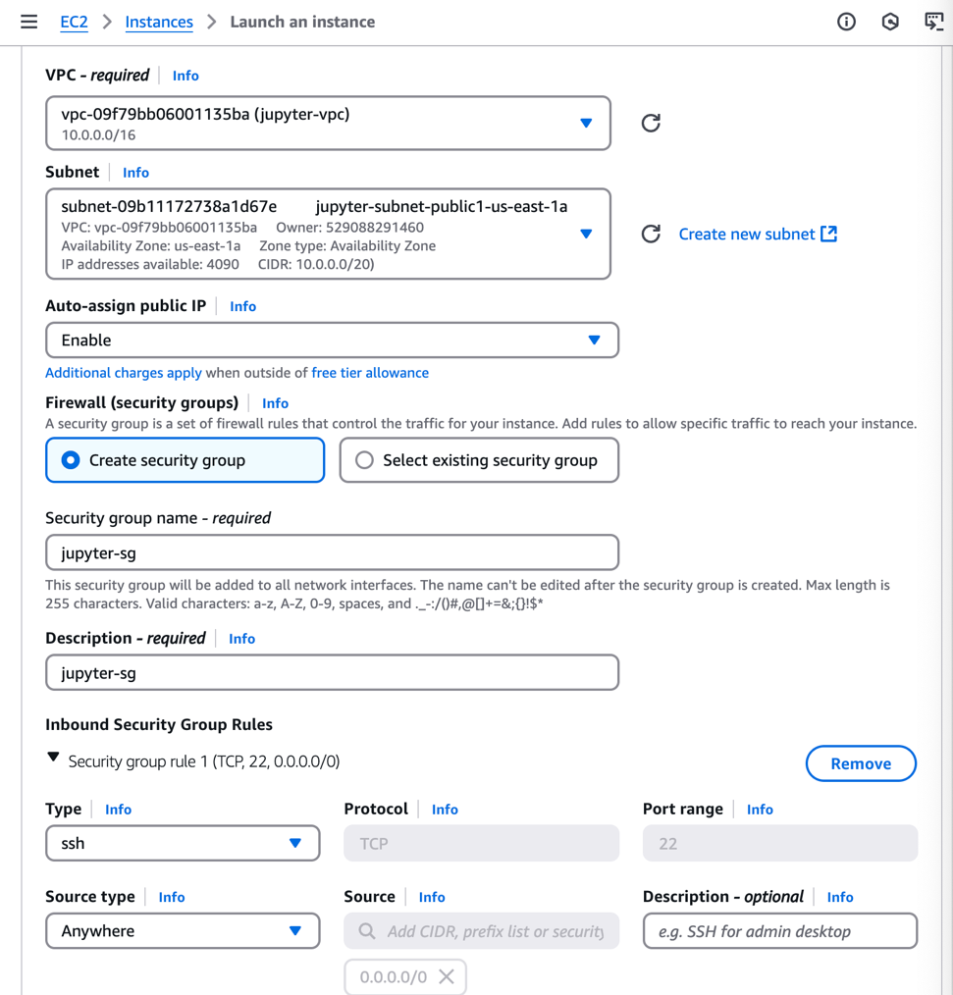
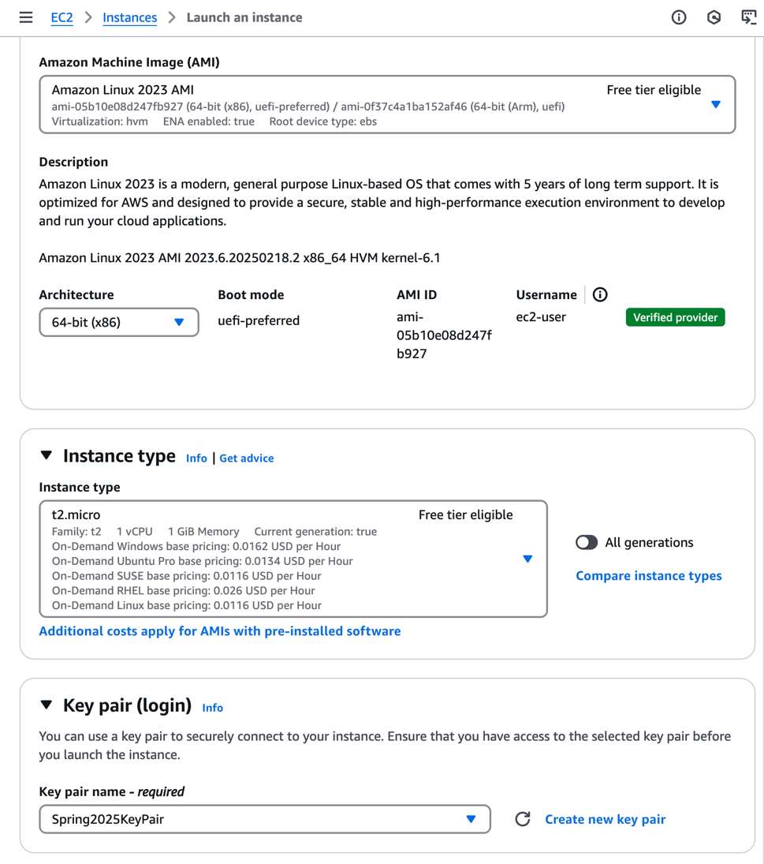
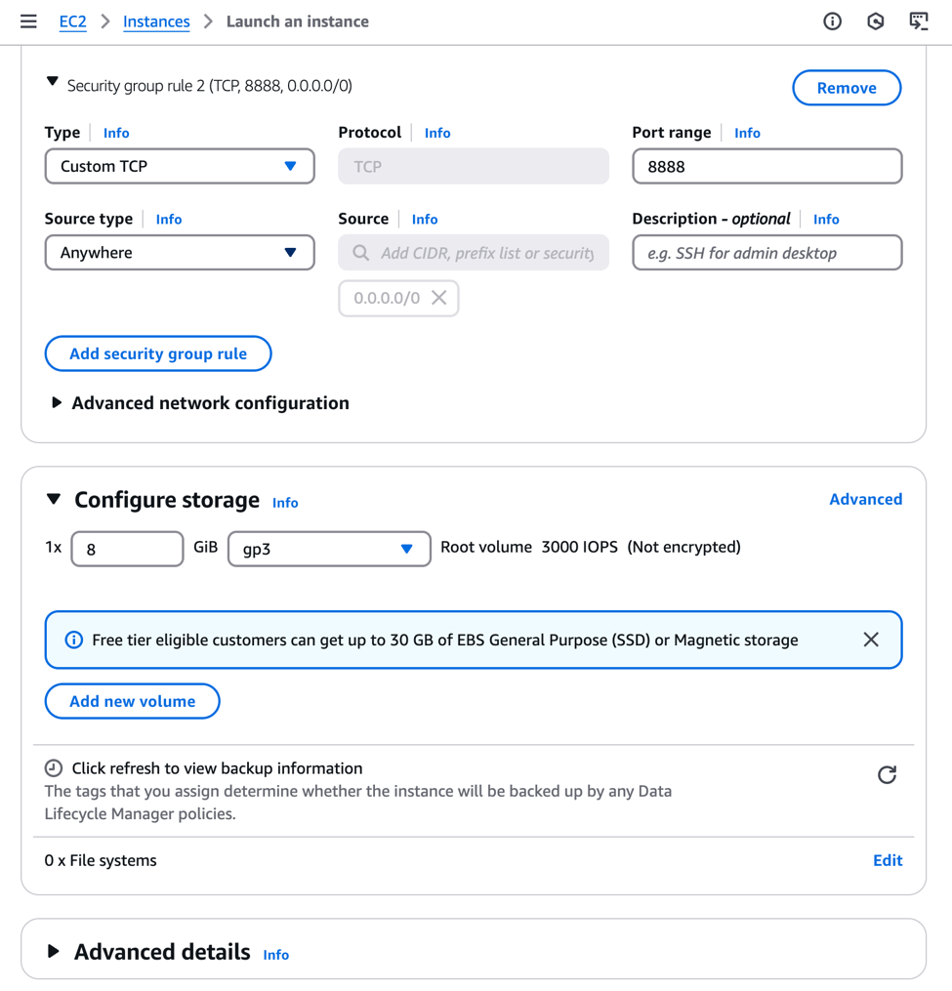
VPC creation
Notes:
1) Went to the EC2 page, pressed the launch instance button. Named the instance jupyter, chose the free-tier option.
2) Chose the free tier options, and chosen the previously created key pair.
3) Chosen the vpc, public subnet, and enabled auto-assigned the public IP. Created a security group.
4)Ensured that port 8888 is added to the security group.
5)Ensured that the instance is created and running. (forgot to screenshot so used groupmate’s screenshot on creating instances)

Slide 7
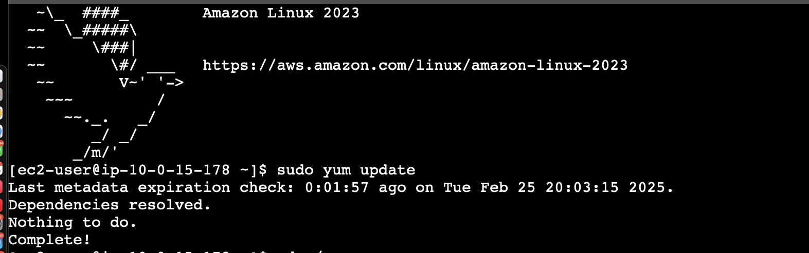
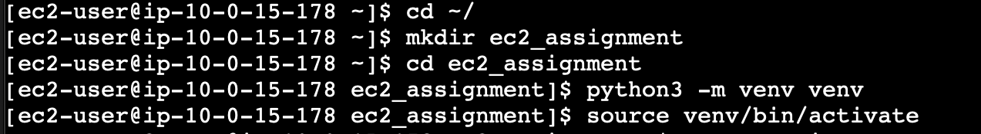
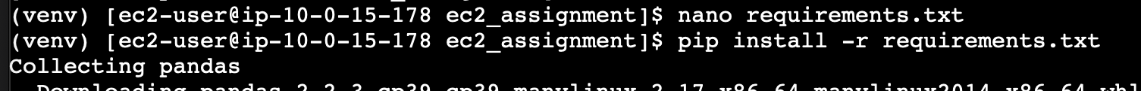
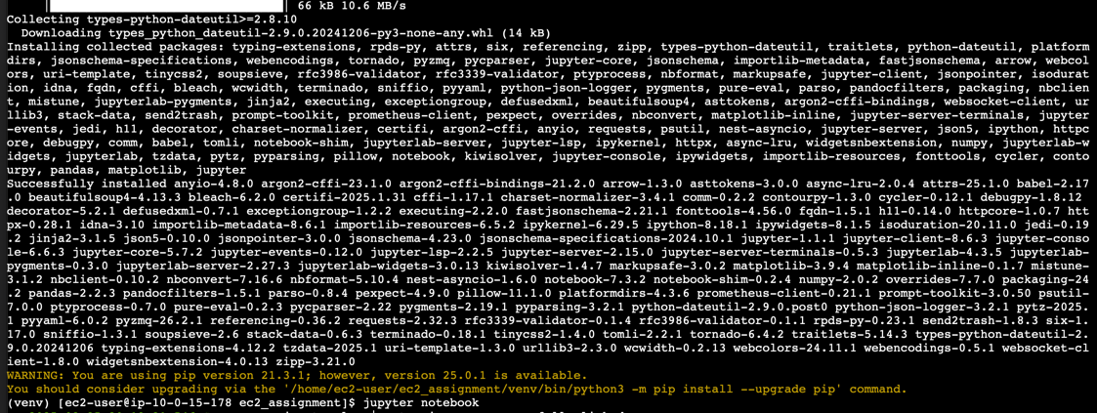
Notes:
Moved to the terminal, ensuring that it is connecting to localhost 8888
Created the ec2_assignment directory, and switched to it. Created a virtual environment and activated it.
Created the requirements.txt file, which contains all the necessary libraries for the project.
Pip installed the libraries from the requirements.txt file.
Going to the link provided in the terminal window to opne jupyter notebook page

Slide 8
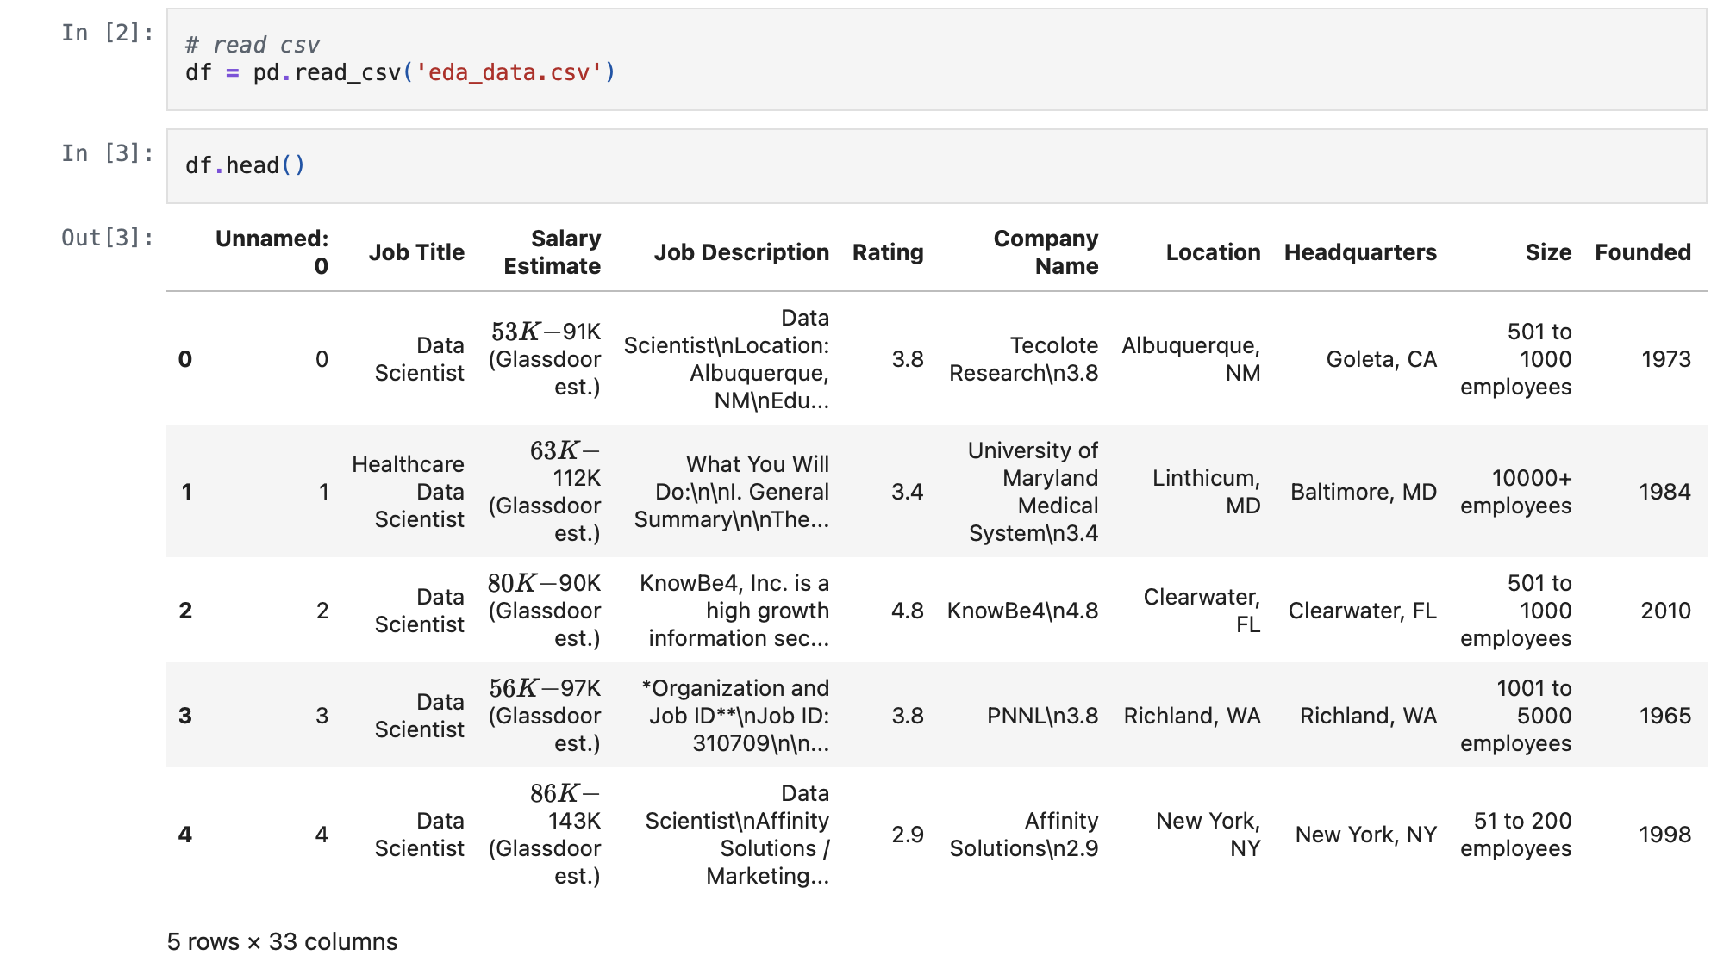

Slide 9
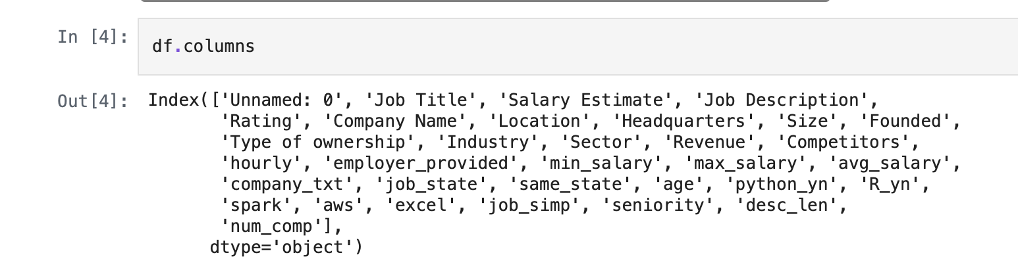

Slide 10
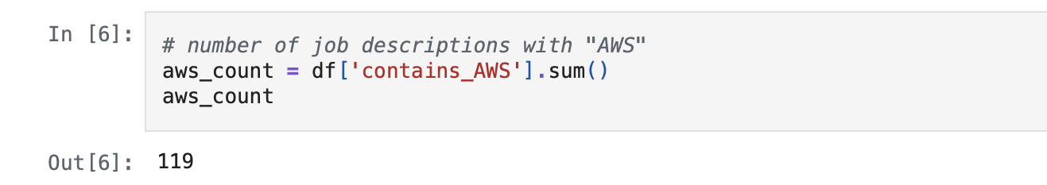

Slide 11
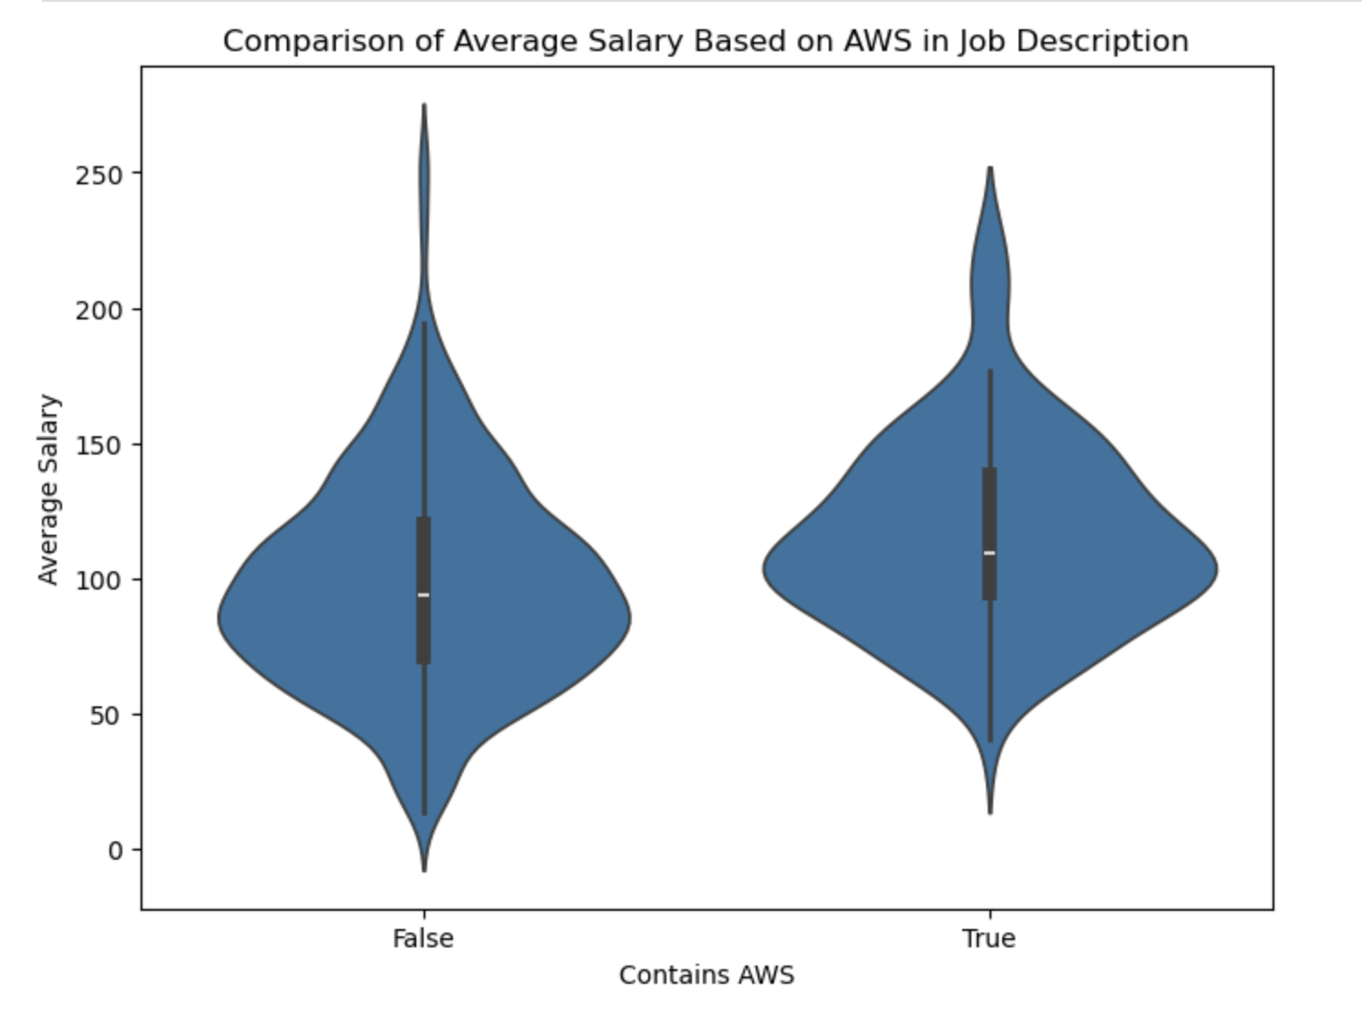

Slide 12
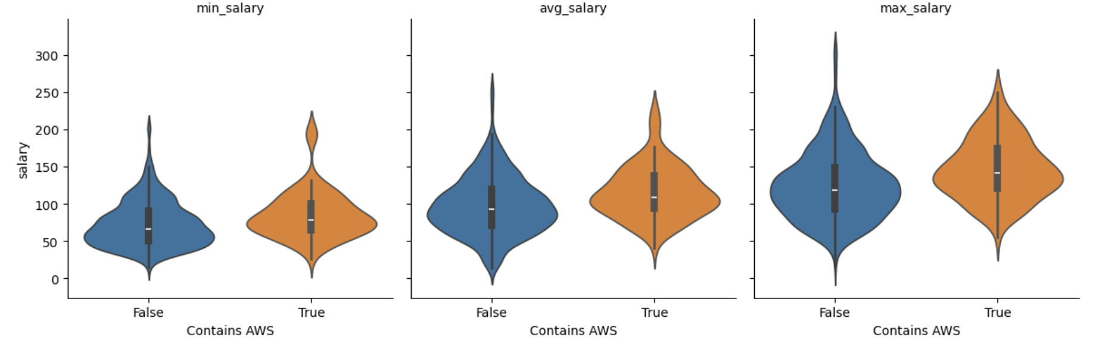
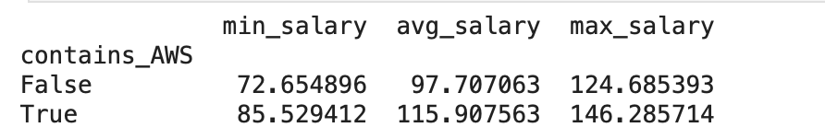

Slide 13
Dashboard Recording

Slide 14
Conclusions
Hypothesis: Jobs that require AWS skill tend to have a higher pay than jobs that don’t
Conclusion: Yes, jobs that require AWS skill tends to have a higher pay than jobs that don’t
Factors for consideration on salary differences:
Cost of living (Location)
Company type (Type of Ownership - government, private, etc.)
Industry/sector (Industry or Sector)
Experience level (Seniority)
Contains AWS | Min Salary | Avg. Salary | Max Salary
True | $86K | $116K | $146K
False | $73K | $98K | $125K

